Slide 1
Your Seat at the Table
Awaits You
Take It!
30 April 2025
CSA Research
Copyright © 2025 by CSA Research

Slide 2
Agenda
Why It’s Your Seat
How to Take It
How to Keep It

Slide 3
Do you have an executive sponsor or champion for your team?

Slide 4

Why It’s Your Seat

Slide 5
Sigh … we’ve been down this road before, Rebecca …

Slide 6

… but now you have a golden ticket!

Slide 7

Gen(AI) is akin to global digital transformation on steroids
Loc teams in the “catbird seat”
  Own and oversee the content, code, and data required for feeding adaptive and proprietary focused LLMs
  Understand how to address the weaknesses of Western Anglophone biases in algorithms and training data
  (Gen)AI implementers need your expertise!

Slide 8
How to Take Your Seat

Slide 9
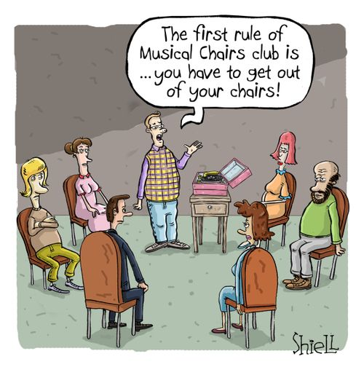
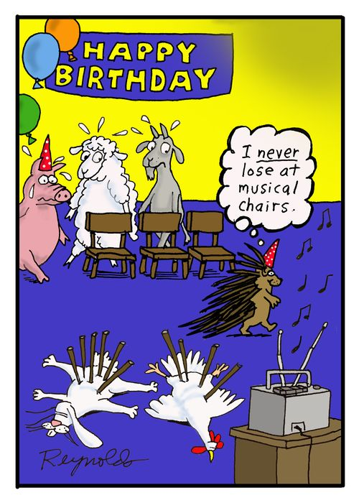

What does your table(s) look like?

Slide 10
Leverage the opportunity
There may not be a seat at the table for localization …
…but there certainly is one for global CX
No initiative that relies on content – and what one doesn’t? – can be successful without your participation
And global CX is what you do!

Slide 11
Do you know the top two or three enterprise-wide initiatives and who’s driving each?

Slide 12
Enlist Finance to guide your path
They know what executives expect
Benefit from their valuable expertise
  Frame the data
  Develop compelling arguments
  Access supporting information
  Learn about executive initiatives

Slide 13
Identify possible supporters, blockers, and the undecided
Create a hit list
  Approach anyone you think might be against or uncommitted
Executives land in three categories
  Supporters
  Blockers
  Undecided

Slide 14
Align what you’re doing with corporate goals and KPIs
What is your company focused on now and over the next 12 months?
How will your team’s expertise help it get there?

Slide 15
Translate your arguments into numbers and data
Upper managers can be intimidated by localization jargon
Replace phrases such as “turnaround time” and “more languages”
Ask for help from Finance, Business Intelligence, and Sales

Slide 16
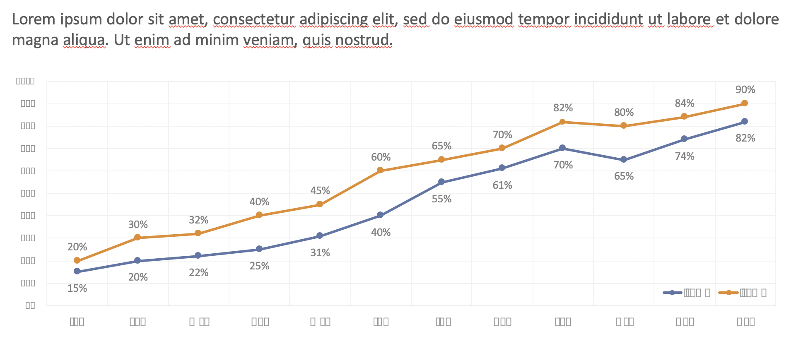
Visualize for your audience
Executives are paid to be strategic
Help them picture the trends and opportunities in the data and graphics
Turn to colleagues in Business Intelligence, Market Research, or design staff

Slide 17
Do a trial run
Seek out blockers or the undecided
Critique your narrative
Address their concerns

Slide 18
How to Keep Your Seat

Slide 19
Speaking business-ese with ease at the table
Use these words …
  TAM
  Investment
  Global DX / CX, etc.
  Market share / competition
  Time-to-market / revenue, etc.
  ROI
  Risk mitigation
  Global expansion
  CSAT scores
  Corporate KPIs / metrics
… but not these
  Cost / Expense
  Faster turnaround
  Higher quality
  Increased throughput
  International customers
  Localization KPIs / metrics
  Word count
Source: “Globalization Maturity Model” © CSA Research

Slide 20
Example: Tables where (Gen)AI decisions are made

Slide 21
Expand your team’s mission
What ideas/tools/processes can my team contribute to stakeholders enterprise-wide to help with growing global business, contributing to profitability, and/or supporting customer retention worldwide?
Don’t wait! Run to find and collaborate with innovators wherever you find them in your organization
  Designers of anything!
  Product managers: Ideation, requirements prioritization, design, creation, testing, launch, post-sales support, sunsetting
  Accessibility – potentially a big one
Source: “UX Design and Localization: Natural Allies” © CSA Research

Slide 22
Expand your team’s mission, cont.
Send an email to your CEO volunteering to help to define your firm’s multilingual (Gen)AI usage policy
Actively push LLM/GPT suppliers to (further) globalize their algorithms and training data
Collect use cases and train IT and internal developers on multilingual LLM development
Educate your innovators
Sources: “The Ethics of Generative AI,” “Locales and Focused Large Language Models (FLLMs),”
and “GenAI Throws Down a Geopolitical Gauntlet” © CSA Research

Slide 23
The scourge of Anglo-centric training data
55 European languages contribute 37.8%. Including English, 85.4% of the data is in European languages
Chinese and Japanese together account for 9.3% of the total
49% other Asian languages add just 3.8%
Percentage of Training Data by Language Group
Four Middle Eastern languages deliver a modest 1.4
51 African, Oceanic, and Indigenous American languages comprise just 0.1%
English accounts for almost half (47.6%) of Common Crawl’s data
Percentage are the portion of all training data in each group in Common Crawl as of May 2023
Source: https://commoncrawl.github.io/cc-crawl-statistics/plot/languages
Sources: “The Ethics of Generative AI” © CSA Research

Slide 24
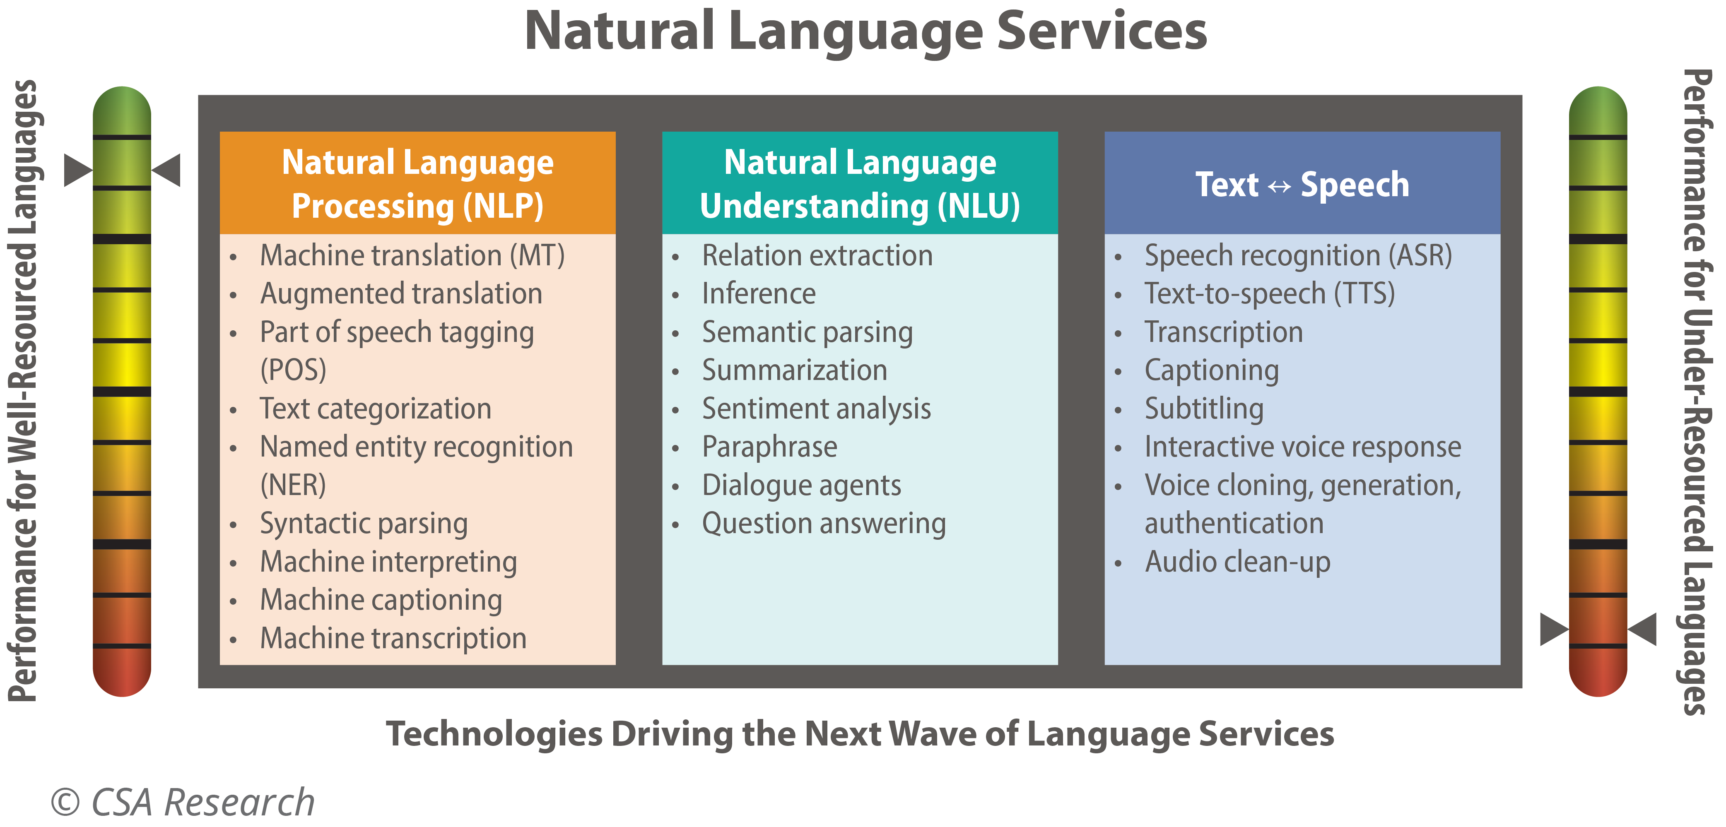
LLM performance depends on language training
Natural Language Services
Natural Language Processing (NLP)
Natural Language Understanding (NLU)
Text ↔ Speech
Machine translation (MT)
Augmented translation
Part of speech tagging (POS)
Text categorization
Named entity recognition (NER)
Syntactic parsing
Machine interpreting
Machine captioning
Machine transcription
Relation extraction
Inference
Semantic parsing
Summarization
Sentiment analysis
Paraphrase
Dialogue agents
Question answering
Speech recognition (ASR)
Text-to-speech (TTS)
Transcription
Captioning
Subtitling
Interactive voice response
Voice cloning, generation, authentication
Audio clean-up
Performance for Well-Resourced Languages
Performance for Under-Resourced Languages
Technologies Driving the Next Wave of Language Services
Sources: “Locales and Focused Large Language Models (FLLMs)” © CSA Research

Slide 25
Keep showing everyone the money
Don’t ask for funding or a higher budget to cover the “cost”
Strike “cost,” “spend,” “pay for,” and “fund” from everyone’s vocabulary
Mantra = Language is a revenue-enabler, not a cost

Slide 26
Double-team with other business functions
Co-present with other teams
Upper managers like collaboration
Power in numbers – arguments bear more weight

Slide 27
Assign memorable names to what you do
Simpler for executives to remember
Easier to track the status of what you’re contributing
You own the success
Increase visibility for language as a revenue-enabler

Slide 28
Ensure that peers can meet their international objectives
Support at the strategic level comes from executives …
… But support for its execution comes from your peers
Spell out the investment required for colleagues to meet their international objectives
Assign a multilingual AI champion within critical functions

Slide 29
Summary: Nine ways to take and keep your seat
Stay on message
Translate into numbers and data
Support peers to meet international objectives
Align with corporate goals and KPIs
Identify supporters, blockers, undecided
Visualize for your audience
Enlist Finance
Double-team
Do trial runs

Slide 30
Warning: Someone else will take your seat if you don’t

Slide 31
Need help?
Want to read more?
“How Do We Recruit an Executive Sponsor?“
“How Can Loc Teams Engage Stakeholders for Major Initiatives?”
“How Can Loc Teams Plan for an Uncertain Future?”
“Raise Visibility for the Value of Globalization Teams”
“Demonstrating the Value of Localization”
“Seize the Day for Localization”
Contact clientservice@csa-research.com to:
Discuss what this data means for your organization
Request additional data
Receive guidance validating your strategy to land a seat!

Slide 32

Thank you!
Rebecca Ray
rebecca@csa-research.com
RESEARCH
INSIGHTS
TWITTER
www.csa-research.com
www.csa-research.com/insights
@CSA_Research

